Slide 1



Market Singapore
2018 Leadership School
#MASGLS2018
Notes:
Agenda overview

Slide 2

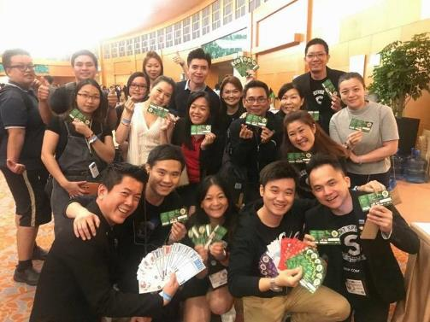
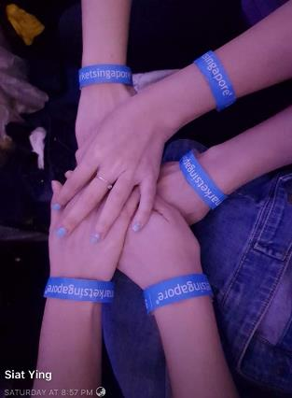
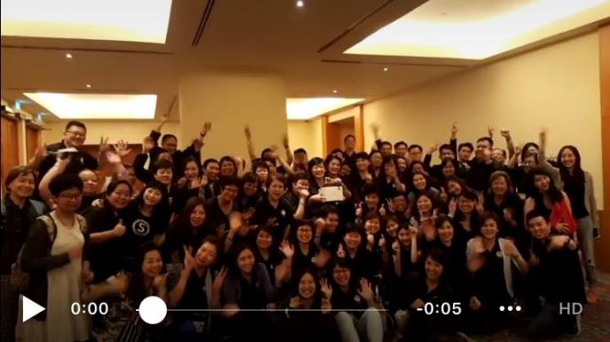



Looking for BEST 3
2018 Leadership School on-site photos!
HASHTAG
#MASGLS2018
WIN 1 x Sponsored Gift by SHOPUFOGear
Notes:
Promotion 1

Slide 3

































Win a gift worth > S$300
TOP 10
PARTNER STORES SPENDERS

Slide 4
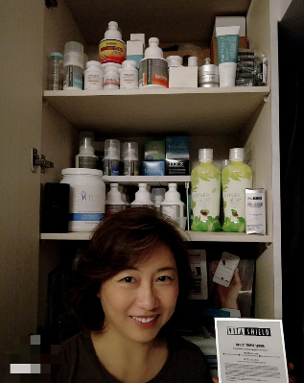
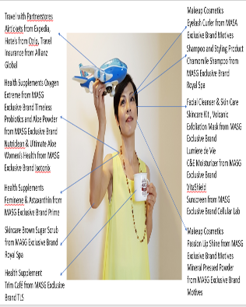

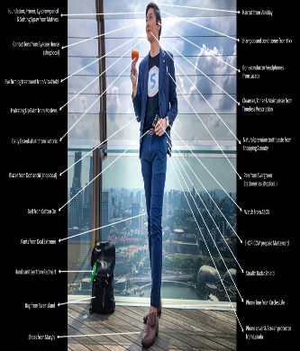
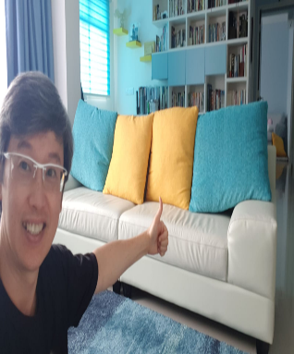
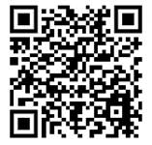
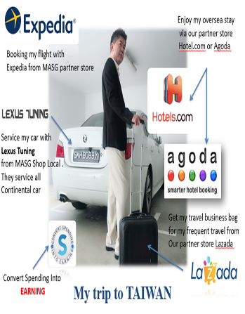


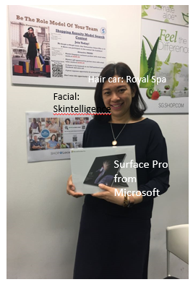
2018 Shopping Annuity Contest
Wong Ying Liza
Lo Yam Heung Maggie
Lucas Leong
Barnabas Lim
Elsa Ng
Lua Hui Mien
Bobby Ho
Normanic Ho
Scan and VOTE
Notes:
Time to vote!

Slide 5
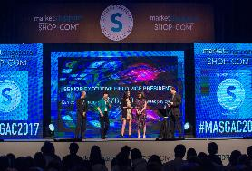
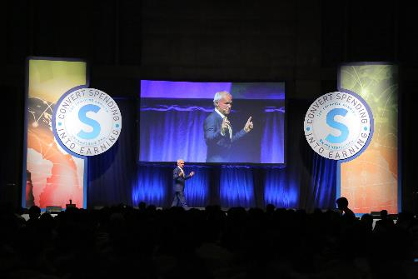

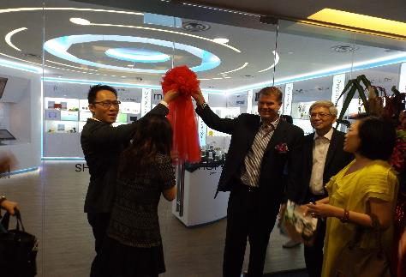
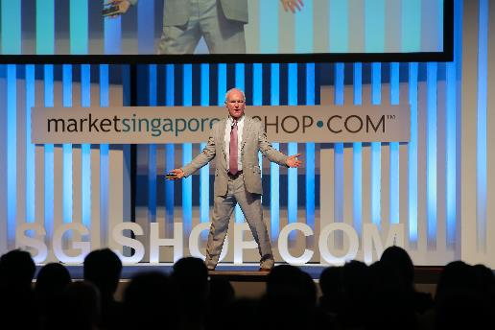


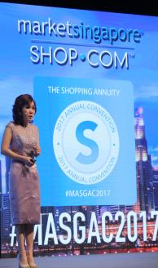


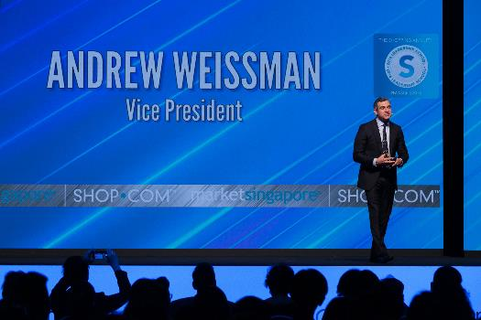

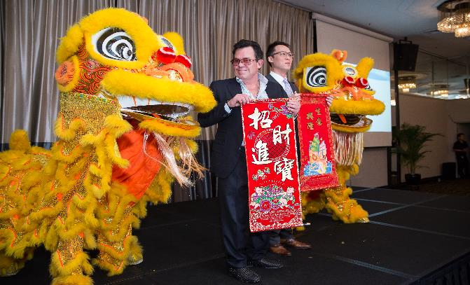




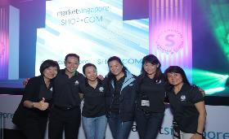


2014 -2017

Slide 6
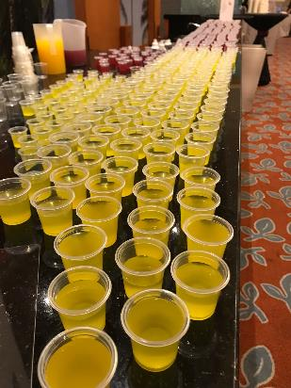
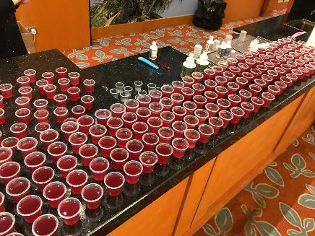
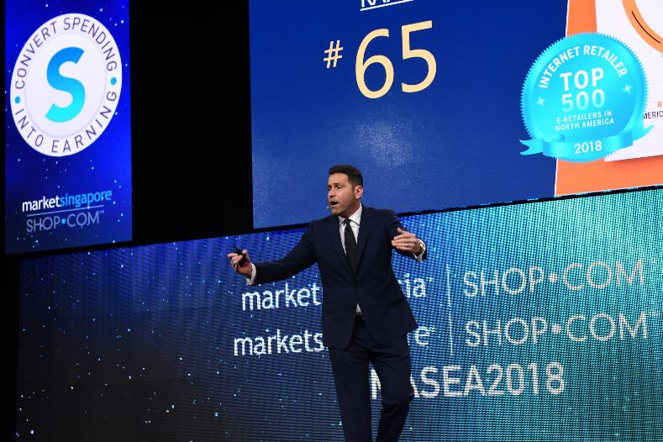
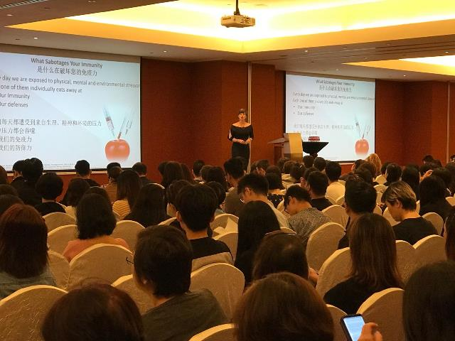

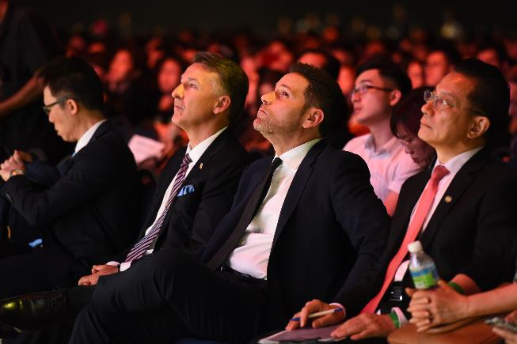
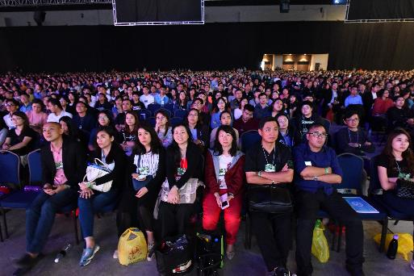
2018

Slide 7
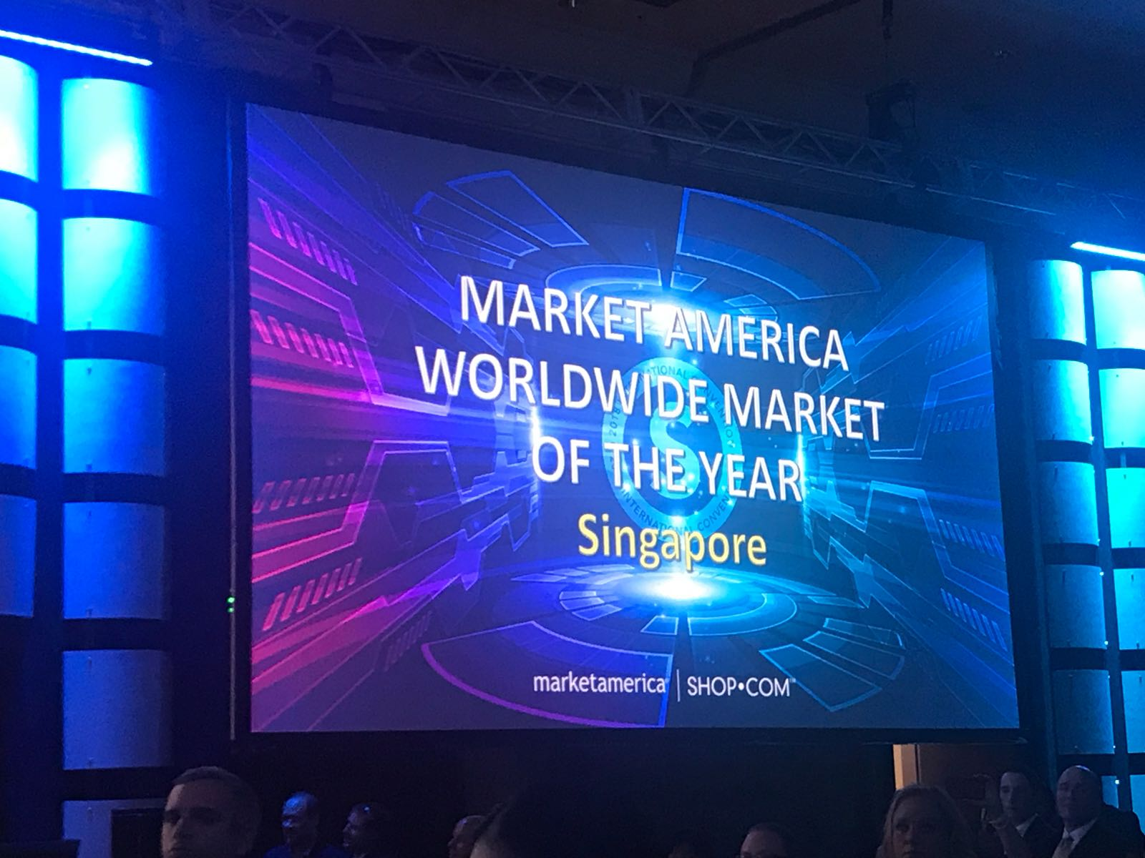
Notes:
Placeholder to cue for video slides…. (video not embedded)

Slide 8


THANK YOU!
Notes:
THANK YOU to all leaders for your continuous support.

Slide 9
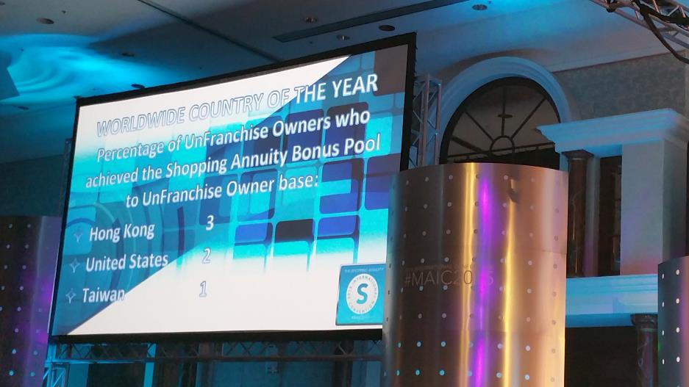
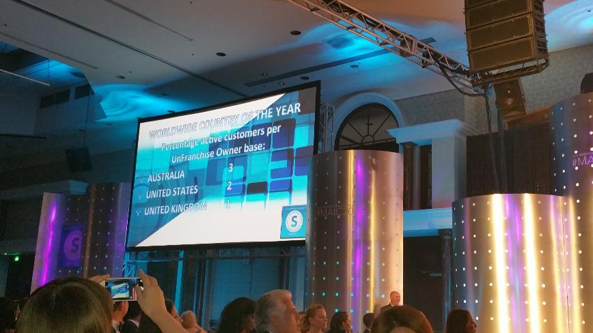
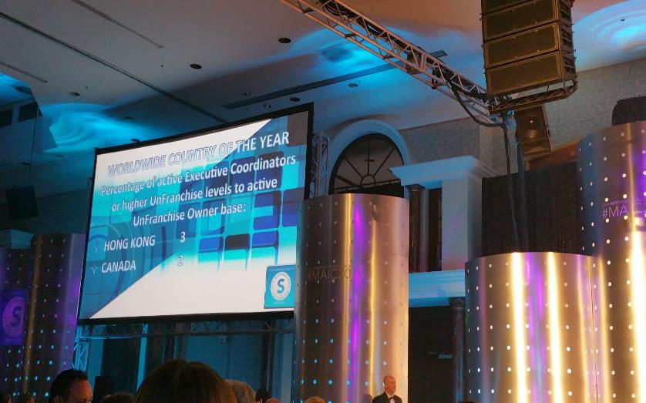
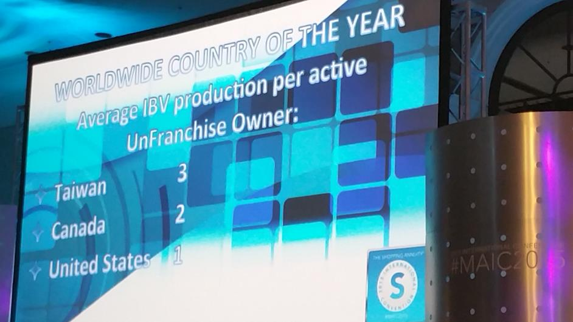
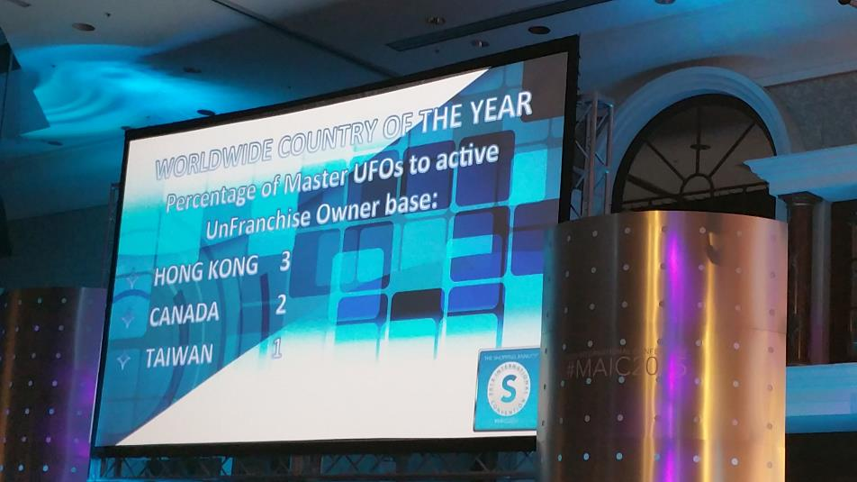
2015
Notes:
Surprise but not lucky..
Percentage Active Customer per UFO base
Percentage of MUFO per active UFO base
Percentage of UFO achieve SABP (SAMM) per UFO base
Average IBV percentage per UFO base
Percentage of Active EC and higher to Active UFO base

Slide 10



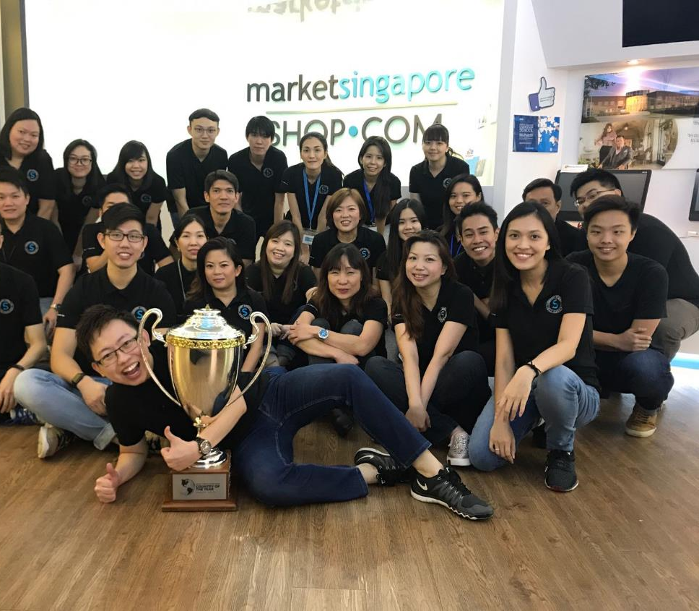
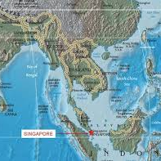

Notes:
Dare to dream… …. Start with your belief, have the right attiude, set the goal and take action, and in time to come …result will arrive

Slide 11
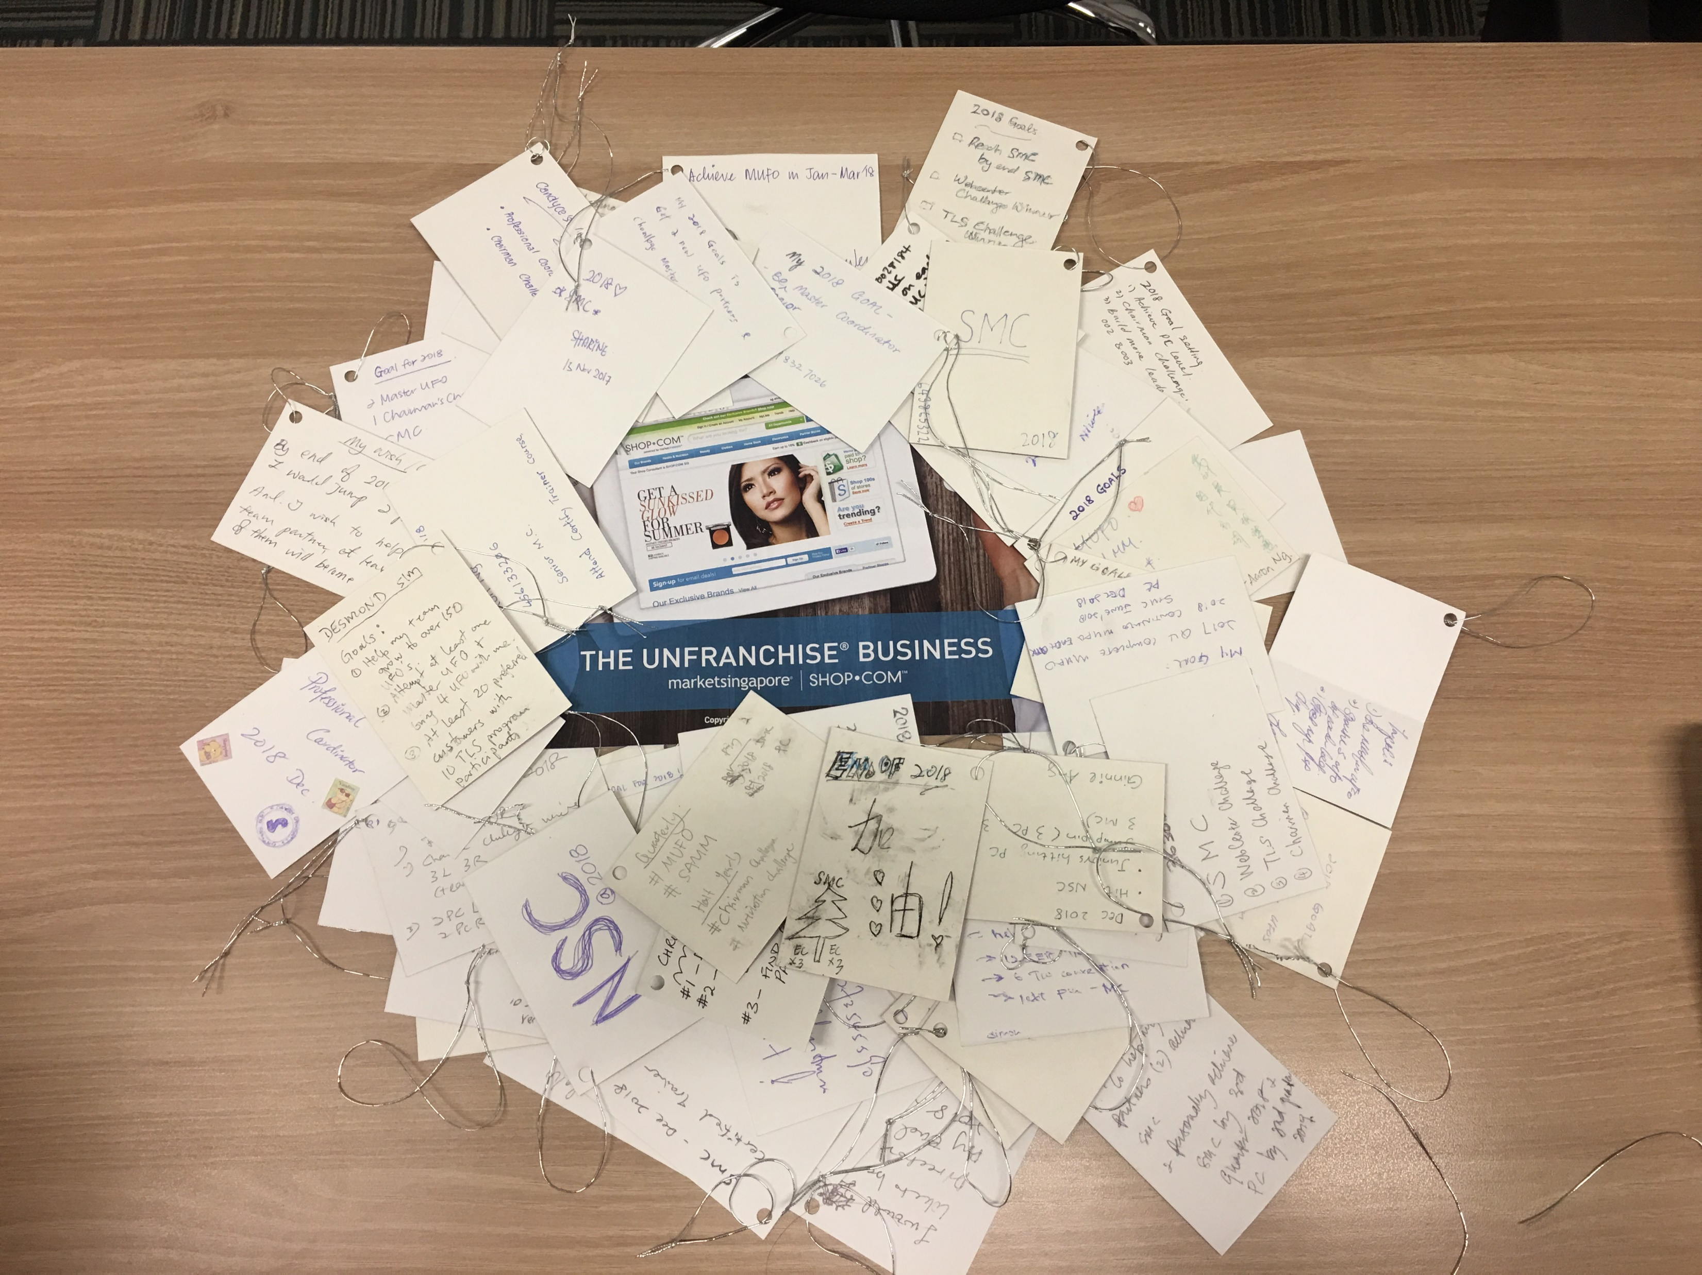
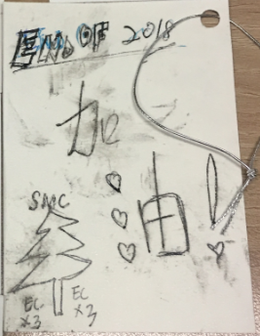

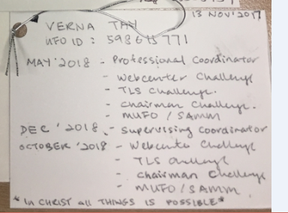
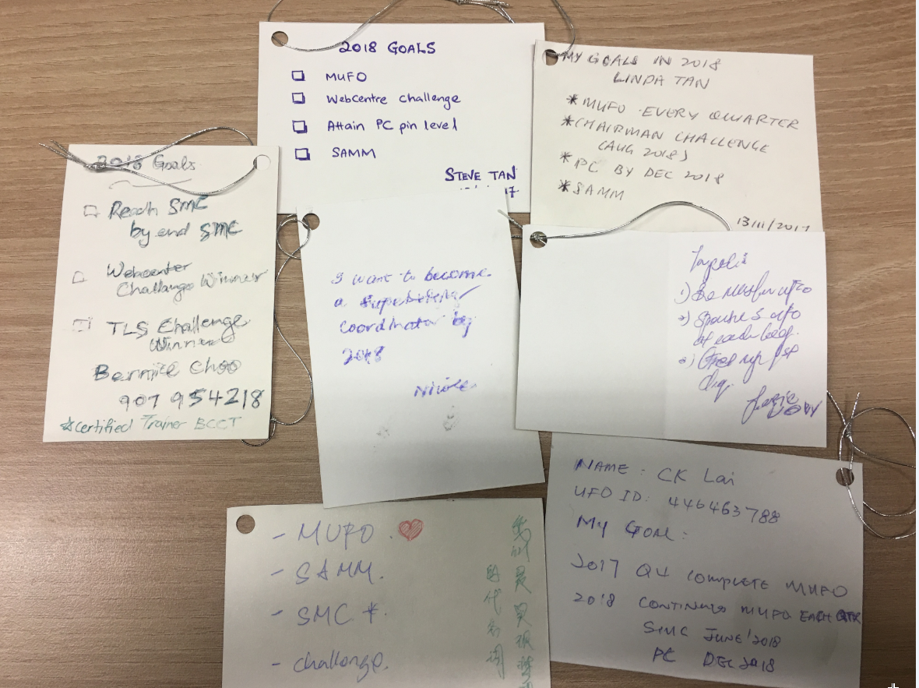
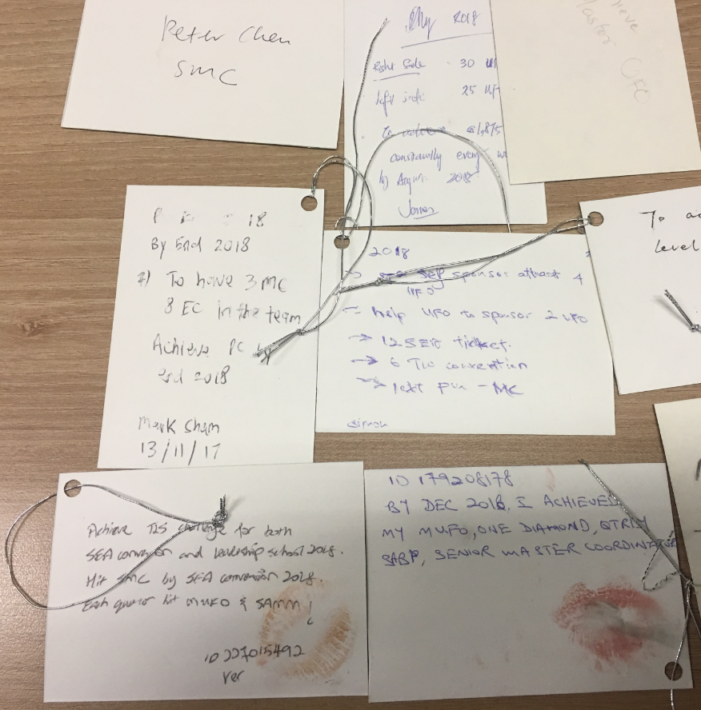
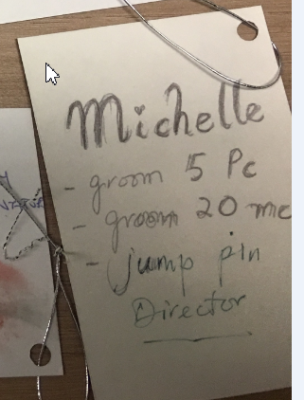
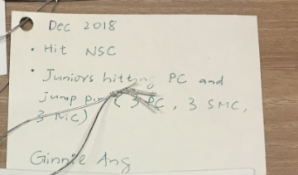
How about you?
Notes:
How about you, will you do what ever it take to be success in this business? Have you set your goal and taken action?

Slide 12


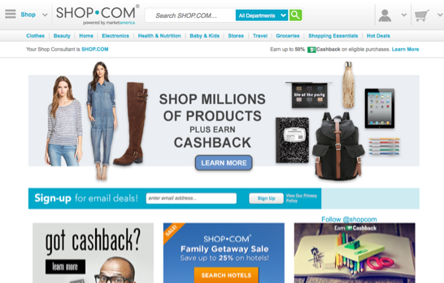
You own one of the BEST ecommerce websites in the World
SHOP.COM
YOU ARE A
BUSINESS OWNER!
Notes:
TRAINER’S NOTES:
Highlight that the winning combination includes the Shop Consultant

Slide 13




Your UnFranchise Business
Marketable | Scalable | Profitable | Sustainable
Notes:
Marketability – Demand?
Scalability – Duplication?
Profitability – Make significant money?
Sustainability – Can it last

Slide 14









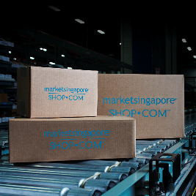








BUILT ON PRODUCT

Slide 15

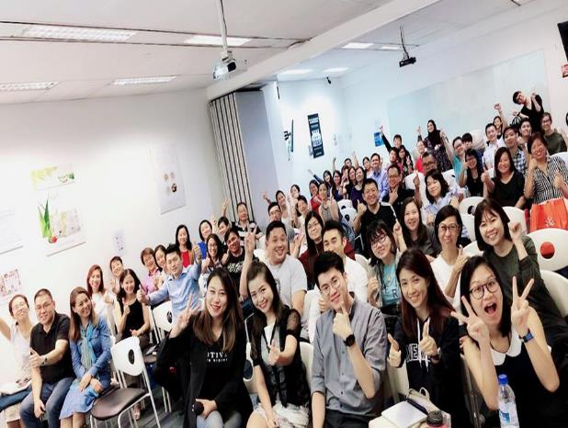
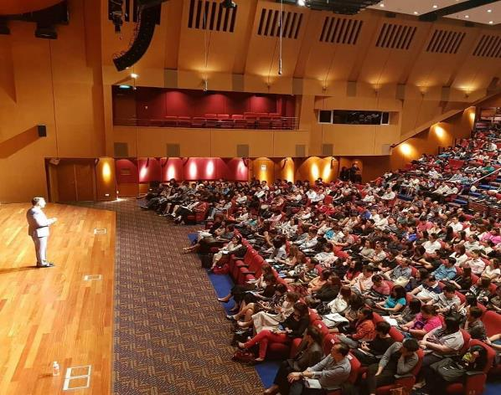
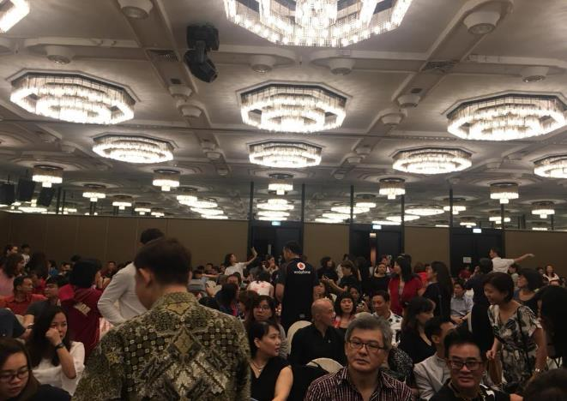
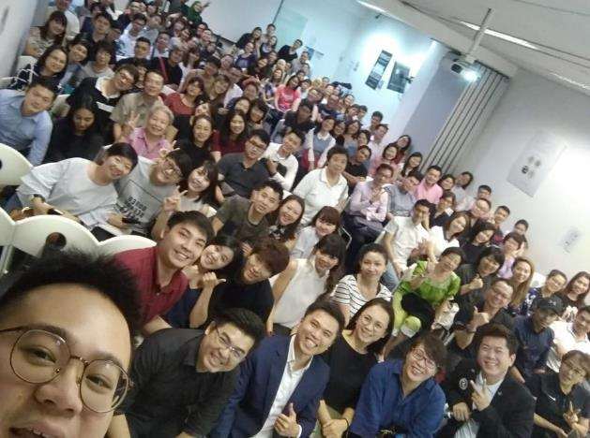
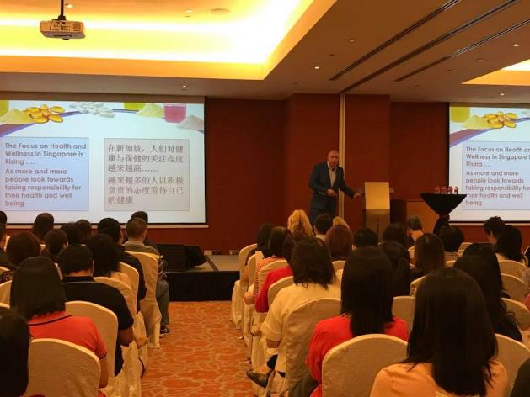
POWERED BY PEOPLE

Slide 16












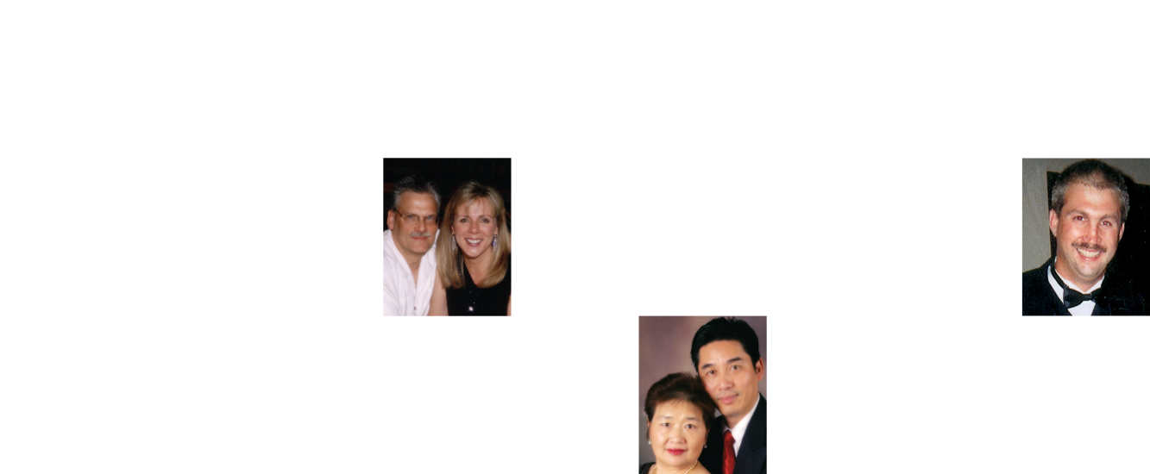














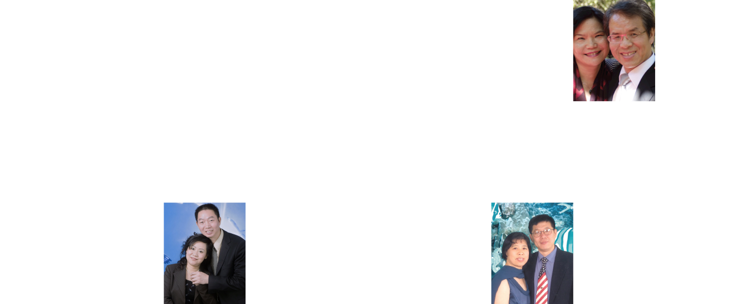








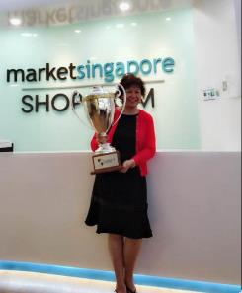
MILLION DOLLARS VLUB
MILLION DOLLARS CLUB MEMBERS
Notes:
THANK YOU to all leaders for your continuous support.

Slide 17

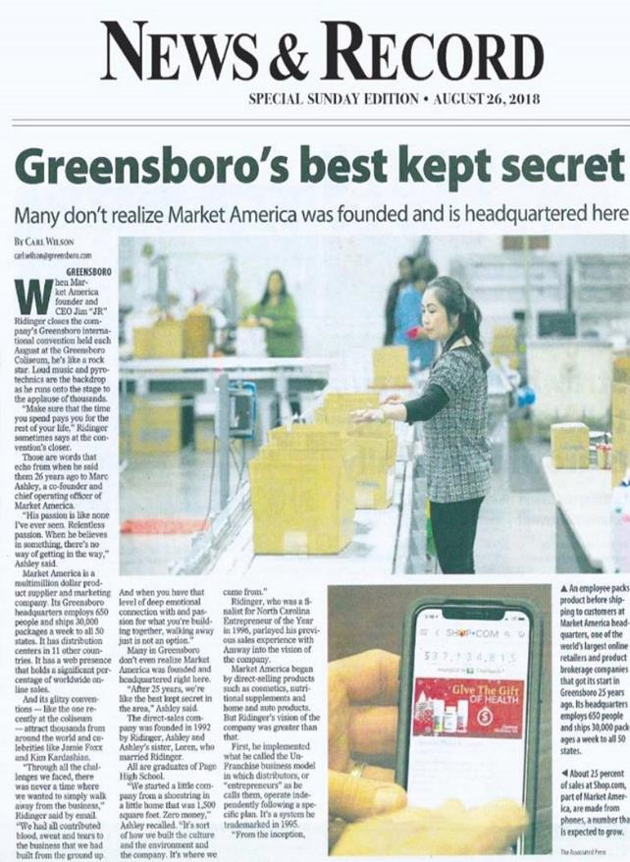







Notes:
THANK YOU to all leaders for your continuous support.

Slide 18

YOU HAVE YOUR WHY, WE HAVE THE HOW!

Slide 19




RESULT PRODUCING ACTIVITIES
Use and Sell
Product
Show the
PLAN
Convert SPENDING
into
EARNING
Share
Education
Notes:
Create a vision of what you want out of life.
Set a pin level goal that will support your vision.
Establish sub goals that support your main goal
Have a deadline for each.

Slide 20

THE UNFRANCHISE® BUSINESS
I am SHOP.COM

